Slide 1
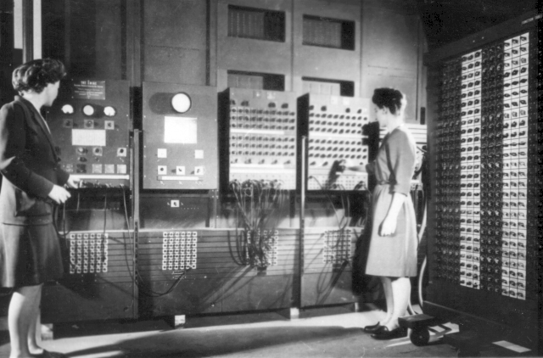
How do compilers and interpreters help develop programs?
A. They give the programmer access to specific functions designed for a specific purpose.
B. They make programs run faster.
C. They allow programmers to write programs without using machine code.

Slide 2
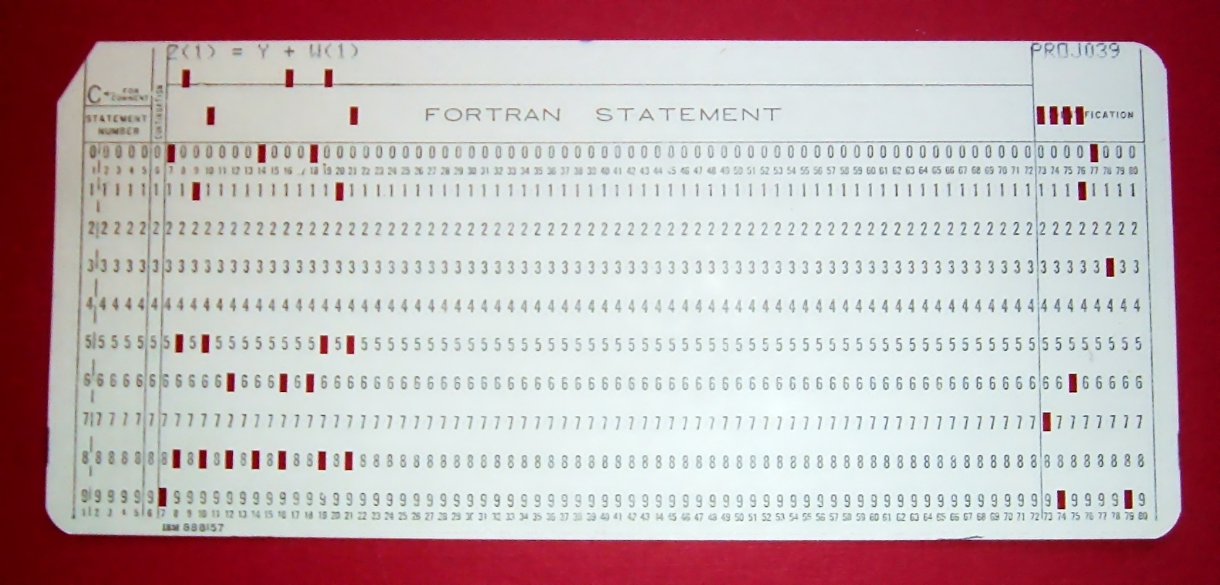
Fortran Punch Card

Slide 3
The programming process
A program performs computations on data. The purpose of data is to represent meaningful information. What information does this problem contain? How do we represent this information as data? What computation needs to be performed on this data to produce new meaningful information?

Slide 4
Functions and Types
Humans
Computer

Slide 5
Functions and Types

Slide 6
Four types
Numbers
Strings
Booleans
Images

Slide 7
Numbers
4
0.1
pi
⅓

Slide 8
Strings
“title”
“name”
“hello”
“21”

Slide 9
Booleans
true
false

Slide 10
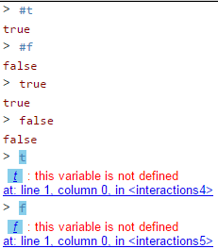
Booleans
true
false

Slide 11

Images

Slide 12
Functions that combine data
Numbers
(+ 3 2)

Slide 13
Functions that combine data
Numbers
(+ 3 2)
5

Slide 14
Functions that combine data
Strings
(string-append “hello_” “world”)

Slide 15
Functions that combine data
Strings
(string-append “hello_” “world”)
“hello_world”

Slide 16
Functions that combine data
Booleans
(and true false)

Slide 17
Functions that combine data
Booleans
(and true false)
false

Slide 18
Functions that combine data
Images
(above )

Slide 19
Functions that combine data
Images
(above
)

